Slide 1
GETTING STARTED
How do we install something we can’t see?

Slide 2
Installing SQL Server
Depending on if we have a Mac or a PC this process will vary
First we’ll look at installing SQL Server on a Mac OSX
We can use that to install SQL Server on Windows
First we need to install Windows

Slide 3
INSTALL ON MAC OSX
OS-ception…

Slide 4
Installing SQL Server on Mac OSx
SQL Server can’t run on any OS that isn’t created and supported by Microsoft
We need a steady platform on Mac OSX for SQL Server to run on
Using a Virtual Machine

Slide 5
Working with Virtual Machines
A Virtual Machine is a file that replicates the behaviour of a Hard Disk Drive
This file will then use the machines resources such as RAM, CPU etc.
The benefits to this are:
Any OS on any machine
Main HDD is not affected
Start fresh any time

Slide 6
Creating Our Virtual Machine
Creating a virtual machine:
In the cloud (using Azure)
Hyper-V
VirtualBox
Docker
We’re going to use VirtualBox which can be downloaded from the Apple App Store…

Slide 7
Configuring Our Virtual Machine
Configuring a virtual machine:
Set RAM allocation
Set HDD file type, size and allocation
Check the Network
Set GFX Card allocation
Now we have our machine set up it’s time to install our guest OS…

Slide 8

Installing Windows
Which version of Windows to install
Windows 10
Windows Server
Windows 8 / 8.1
Windows 7
Windows Vista / XP
We are going to install Windows Server 2016…

Slide 9
Installing SQL Server
SQL Server Express can be downloaded from the SQL Server website
However, this must be downloaded on the Guest OS – this will make it easier to install
May take a while - but is easiest part of our install

Slide 10
Configuring Windows & SQL Server
Now we have everything installed we need to get it all set up, this includes:
Starting the SQL service
Enabling SQL Mixed mode & Remote Connections
Set & open the Firewall Port
Let’s see how it’s done…

Slide 11
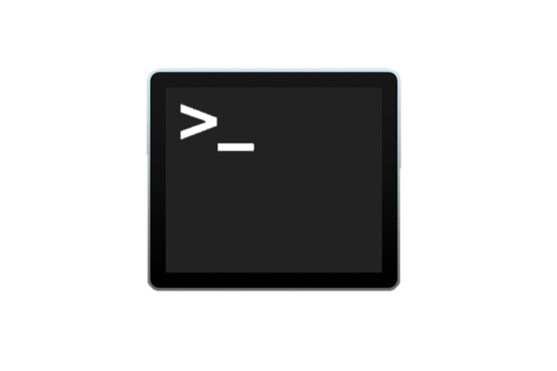
Testing Our Connection
Take five minutes to test our connection the server
We do this using Terminal and by ‘pinging’ our virtual machine
Enter ping followed by the IP address of our server
E.g. ping 192.168.0.1
If our ping is successful we will see the time it took to get a response
If our ping is unsuccessful we we see a message advising that our response timed out

Slide 12
Shedding The Virtual Machine Skin
Let’s get back to our Mac OSX…
To access our database we use SQL Pro For MSSQL which can be downloaded from the SQL Pro Website
Now the last thing we need to do is connect to our database…

Slide 13

CHALLENGE TIME!
If you own an Apple Mac get all these tools installed:
VirtualBox
Windows Server 2016
SQL Server Express
SQL Pro for MSSQL
For bonus points, change the configuration settings on one or more:
VirtualBox
Windows Server 2016
SQL Server Express
Share a screen shot on our Discord Community and tell us any challenges you faced and/or over come

Slide 14
INSTALL ON WINDOWS
Home Sweet Home

Slide 15
Installing SQL Server on Windows
SQL Server can’t run on any OS that isn’t created and supported by Microsoft
We need a steady platform on Mac OSX for SQL Server to run on
With Windows we already have this platform
So we jump right in…

Slide 16
Installing SQL Server
SQL Server Express can be downloaded from the SQL Server website
May take a while - but is easiest part of our install

Slide 17
Configuring Windows & SQL Server
Now we have everything installed we need to get it all set up, this includes:
Starting the SQL service
Enabling SQL Mixed mode & Remote Connections
Set & open the Firewall Port
Let’s see how it’s done…

Slide 18
Testing Our Connection
Take five minutes to test our connection the server
We do this using the Command Line and by ‘pinging’ our SQL Server on the open port
Enter ping followed by the IP address of our PC, followed by the port number
E.g. ping 192.168.0.1:1433
If our ping is successful we will see the time it took to get a response
If our ping is unsuccessful we we see a message advising that our response timed out

Slide 19

Working With Our SQL Server
Working? That’s great! But do we have to work with this console the whole time…
To access our database we use Microsoft SQL Server Management Studio which we installed along with our server
Now the last thing we need to do is connect to our database…

Slide 20
CHALLENGE TIME!
If you haven’t already, then get to installing SQL Server on your PC or Mac
Share any issues and how you overcame them on our Discord channel

